Slide 1
Feasibility Study
Elias M Awad, System analysis and Design

Slide 2
Feasibility Study
Feasibility Study is carried out to select the best system that meets the performance requirement. This includes identification, description, and evaluation of the candidate systems and select the best system for the job.

Slide 3
System Performance Definition
A system required performance is defined by describing its output in a user acceptable format and at a higher level of detail than what was described in preliminary investigation. This involve three steps:
Statement of Constraints: Constraints are factor that limit the solution of a problem.
Identification of specific system objective: The steps are to state the system’s benefit and translate them in measurable objectives.
Description of outputs: Describe the output required by the user.

Slide 4
Feasibility Study
Feasibility study needs to answer the following question:
Is there a new and better way to do the job that will benefit he user?
What are the cost and saving of the alternative?
What is recommended?

Slide 5
Feasibility Consideration
The key consideration involve in feasibility analysis are:
Economical feasible
Technical feasibility
Operational feasibility

Slide 6
Steps in Feasibility Analysis
Feasibility analysis involve eight steps:
Form a project team and appoint a project leader.
Prepare system flow charts.
Enumerate potential candidate system.
Describe and identify characteristic of candidate systems.
Determine and evaluate performance and cost effectiveness of each candidate system.
Weight system performance and cost data.
Select the best candidate system.
Prepare and report final project directive to management.

Slide 7

Steps: 01 in Feasibility Analysis
1. Form a project team and appoint a project leader
- Leading a project towards success requires a project leader to get the work done by the team members efficiently and effectively.
- Communication, management, sharing a vision, honesty, planning, flexibility and decision
making are all leadership skills that a good
project leader should have.

Slide 8
Steps: 02 in Feasibility Analysis
2. Prepare system flow charts
- The charts bring up the importance of inputs, outputs and data flow among key points in the existing system.
- Different types of information-oriented charts(e.g. data flow diagrams) are prepared and reviewed.

Slide 9
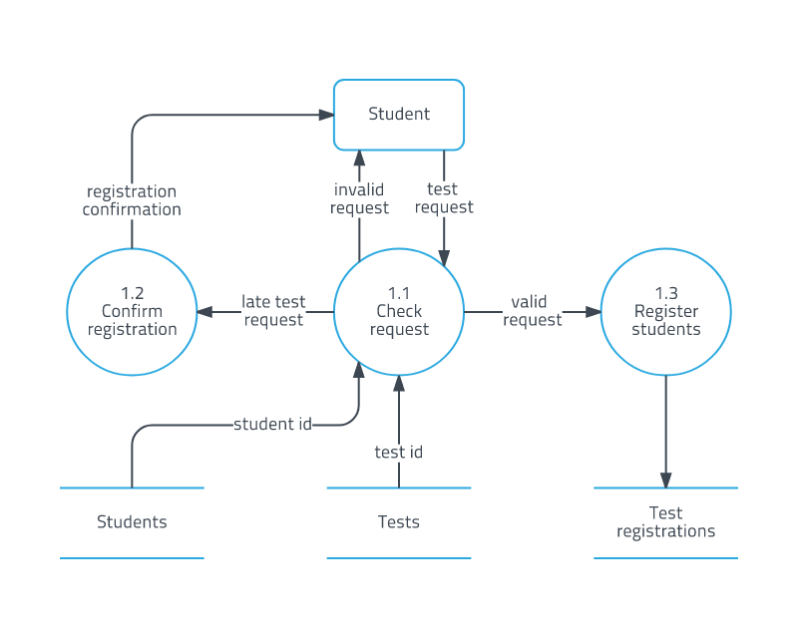
Steps: 02 in Feasibility Analysis

Slide 10
Steps: 03 in Feasibility Analysis
3. Enumerate potential candidate system
- Potential candidate systems are identified that are capable of producing the required outputs.
- Hardware and software requirements for each candidate system are identified to transform from logical to physical system models.
Candidate Systems | Hardware | Software
C1 | IBM PC | Linux
C2 | Apple III | Windows

Slide 11
Steps: 04 in Feasibility Analysis
4. Describe and identify characteristic of candidate systems
- A preliminary evaluation is done to reduce to a manageable number of candidate systems.
- Technical knowledge and expertise in the hardware/software area are critically analyzed to determine what a candidate system can/cannot do.

Slide 12
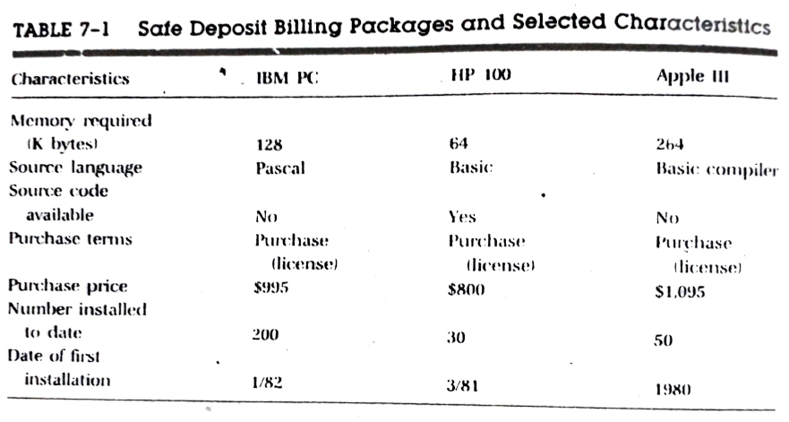
Steps: 04 in Feasibility Analysis

Slide 13
Steps: 05 in Feasibility Analysis
5. Determine and evaluate performance and cost effectiveness of each candidate system
- Each candidate system’s performance, cost etc. are evaluated against the system performance requirements to select the best system.
- Evaluation is often done using qualitative measures rather than quantitative terms.

Slide 14
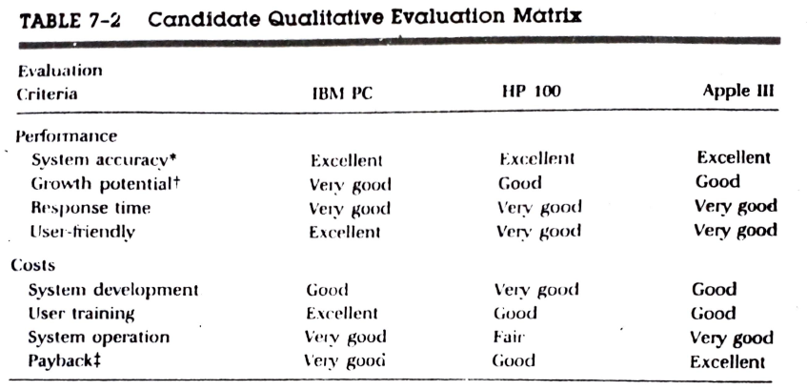
Steps: 05 in Feasibility Analysis

Slide 15
Steps: 06 in Feasibility Analysis
6. Weight system performance and cost data
- Limitation: the performance and cost data might not always help to select the best choice.
- Solution: A quantitative weighted rating is used to weight the importance of each criterion. The candidate system with the highest total score is selected.

Slide 16
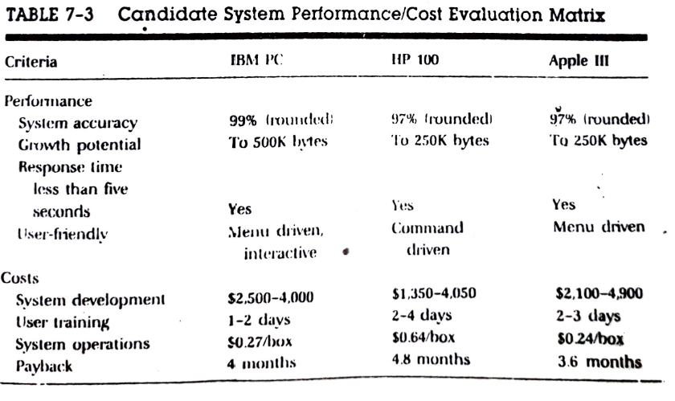
Steps: 06 in Feasibility Analysis

Slide 17
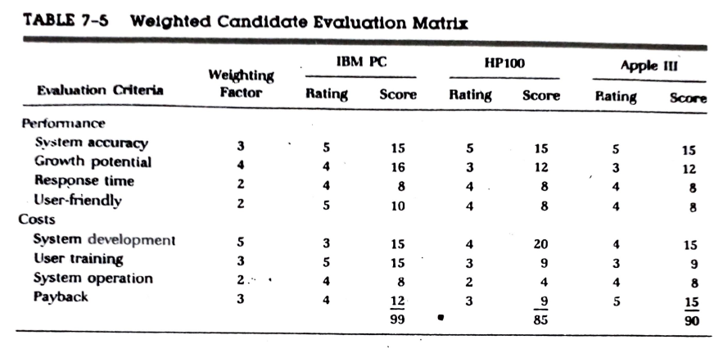
Steps: 06 in Feasibility Analysis

Slide 18
Steps: 07 in Feasibility Analysis
7. Select the best candidate system
- The system with the highest total score is judged and selected as the best system.
- This assumes the weighting factors are fair and rating of each evaluation criterion is accurate.

Slide 19
Steps: 08 in Feasibility Analysis
7. Prepare and report final project directive to management
- The evaluation results and process obtained from previous steps are culminated into a formal feasibility report and directed to the management.

Slide 20
Feasibility Report
The feasibility report should be:
A formal document for management use
Breif enough
Sufficiently nontechnical to be understandable
Detailed enough to provide the basis for system design
There is no standard format to prepare feasibility report
Analyst usually decide on a format that suits the particular user and system

Slide 21
Feasibility Report
Tentative sections of Feasibility Report
Cover letter
Table of Contents
Overview
Narrative explanation of the purpose and scope of the project
The reason for undertaking the feasibility study
The department involved/affected by the candidate system
Also: Names of the persons who conducted the study, when it began, and other information that explain the circumstances surrounding the study.
(Objectives of the project, The needs for the project, Overview of the existing systems and technologies, Scope of the project, Deliverables)

Slide 22
Feasibility Report
Tentative sections of Feasibility Report
Detail Findings
Methods used in the present system (it’s effectiveness, efficiency, and operating costs are emphasized)
Provides the objectives and general procedures of the candidate system (output, cost, and benefits gives management a feel for the pros and cons of the candidate system)
Economic Justification
Point-by-point cost comparison and preliminary cost-estimate for the development and operation of the candidate system
A ROI analysis of the project
Recommendations and Conclusions
Suggest to management most beneficial and cost-effective system
Should be written as a recommendation, not a command
Following the recommendations, any conclusions from the study may be included.
Appendixes
Document all memos and data compiled during the investigation.

Slide 23
The END

